Slide 1


SUBMITTED BY, KARTIK M 2SD19IS402 PRASHANT S N 2SD18IS031 SARDAR PARAMJEET SINGH 2SD18IS044 SUSHMA S 2SD18IS056
SDM COLLEGE OF ENGINEERING AND TECHNOLOGY DHAVALAGIRI, DHARWAD
DEPARTMENT OF INFORMATION SCIENCE & ENGINEERING
Team :P15

Slide 2

“Media Control using Hand Gesture Moments”
CONTENTS
INTRODUCTION
METHDOLOGY
IMPLEMENTATION
RECOGNITION RATE OF DIFFERENT GESTURES
CONCLUSIONS

Slide 3
INTRODUCTION
A hand gesture recognition system provides a natural, innovative and modern way of non - verbal communication. It has a wide area of application in human computer interaction and sign language. The intention of this implementation is to discuss an approach of hand gesture recognition based on detection of some shape based features.
A primary goal of gesture recognition is to create a system which can identify specific human gestures and use them to convey information for device control and by implementing real time gestures recognition a user can control a computer by doing a specific gesture in front of a video camera linked to a computer.
In this project we will develop a “Media Control using Hand Gesture Moments” with the help of OpenCV module and other technologies.

Slide 4

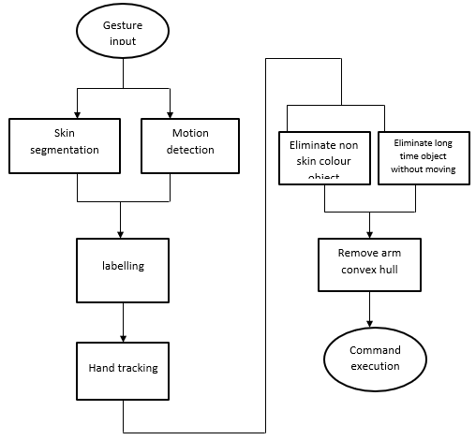
Gesture recognition helps computers to understand human body language. This helps to build a more potent link between humans and machines, rather than just the basic text user interfaces or graphical user interfaces (GUIs). In this project for gesture recognition, the human body's motions are read by computer camera. The computer then makes use of this data as input to handle applications. The objective of this project is to develop an interface which will capture human hand gesture dynamically and will control the volume level
METHDOLOGY

Slide 5
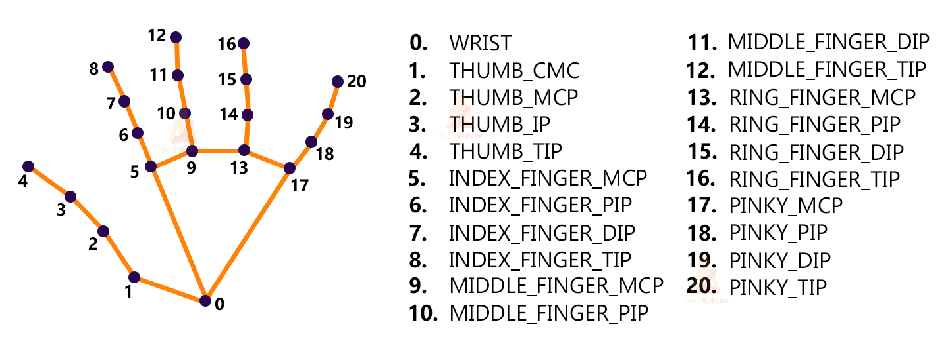
IMPLEMENTATION

Slide 6
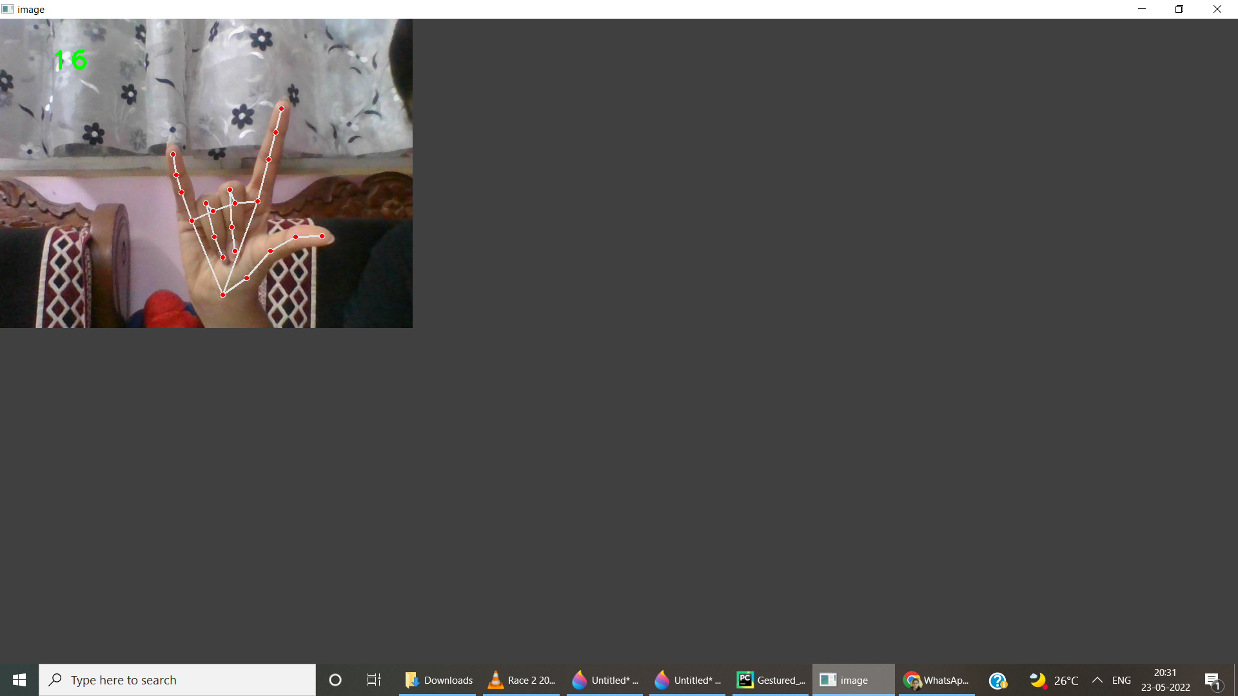
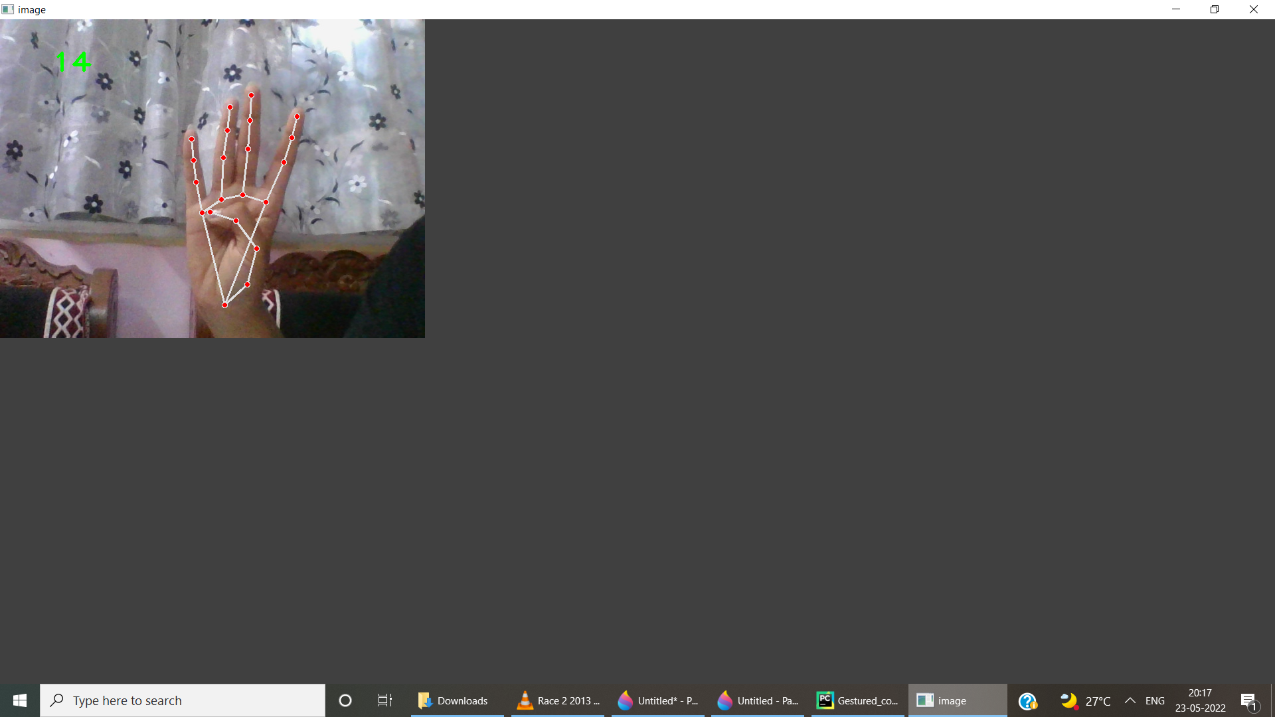
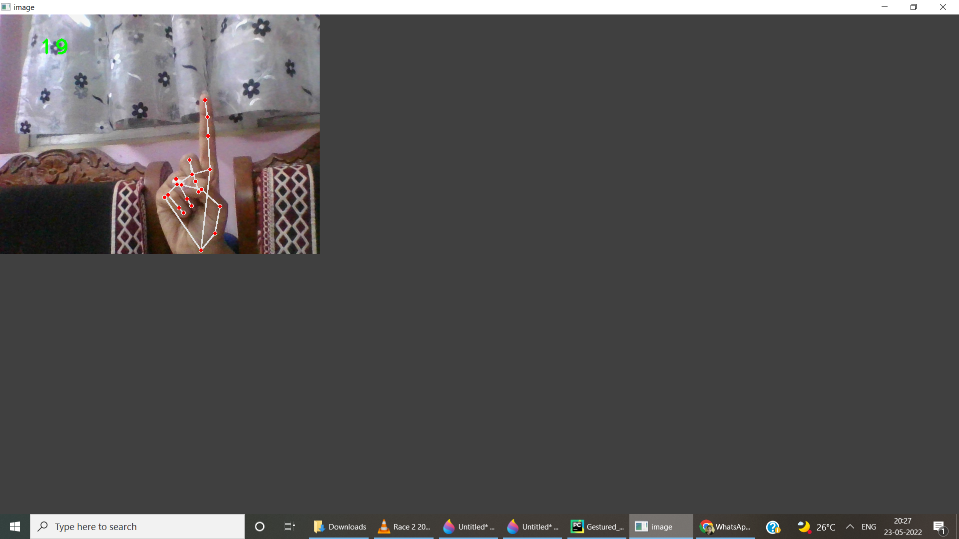
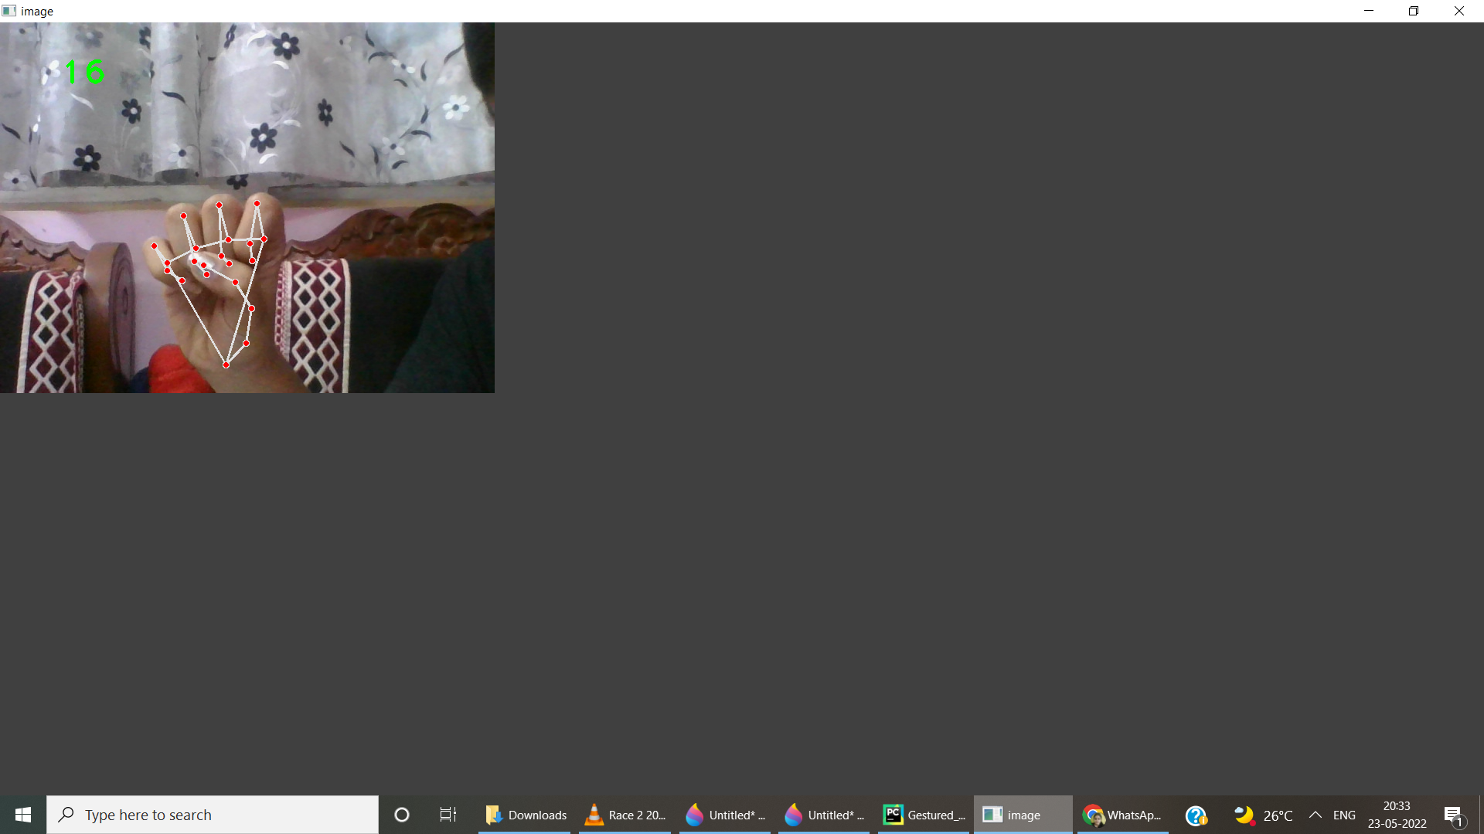
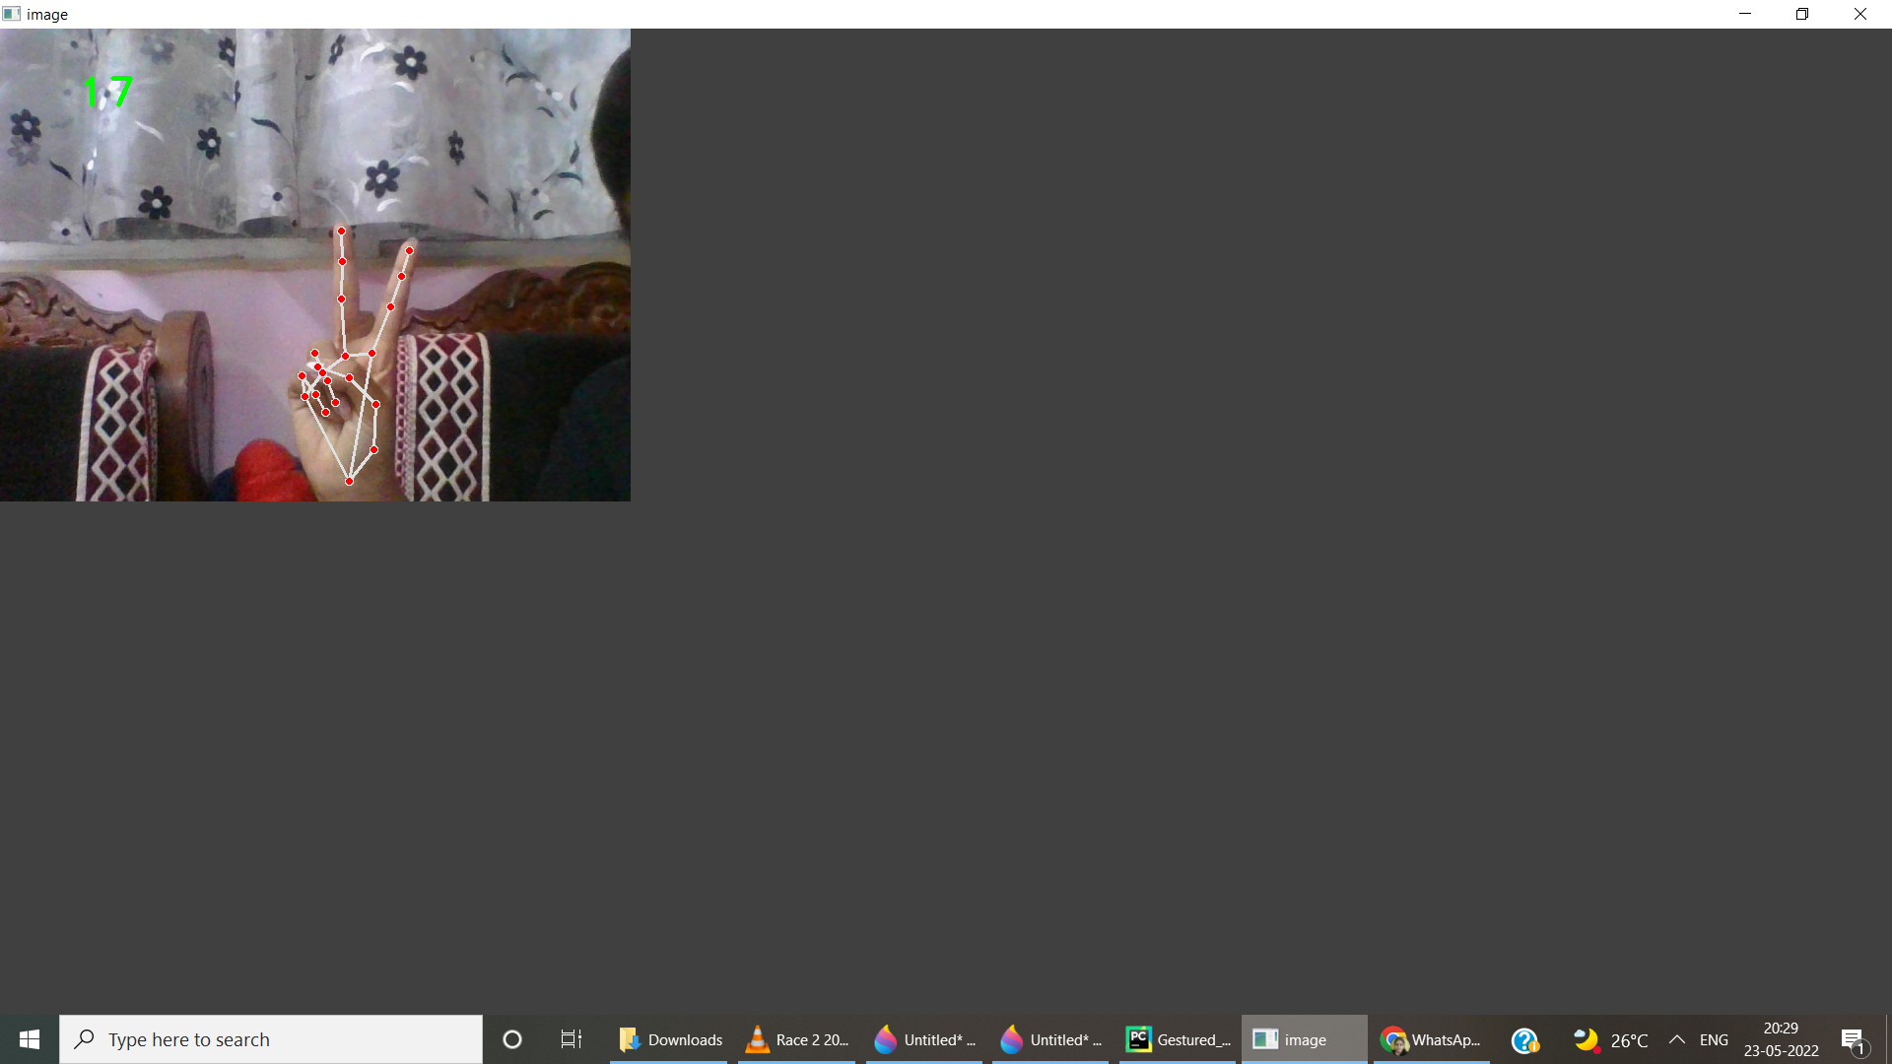
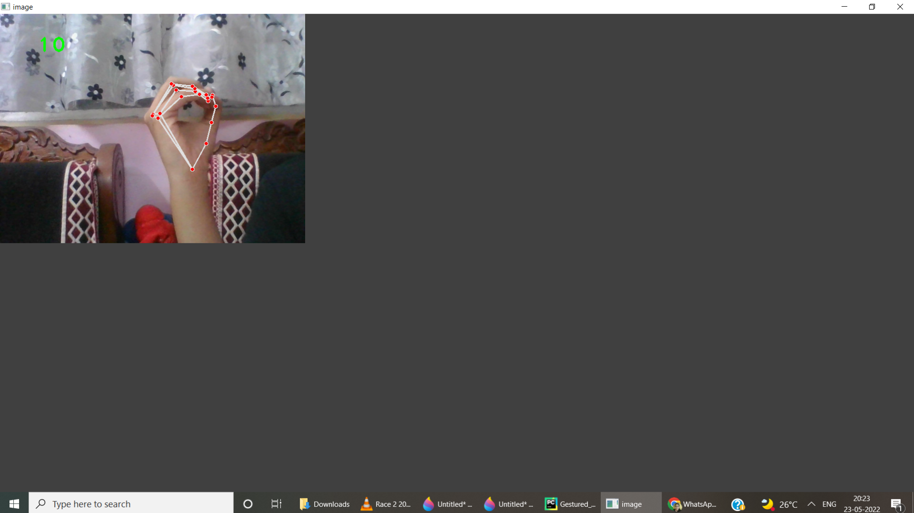
(b)
(c)
(a)
(b)
(d)
(e)
(f)
(a)Increase Volume (b)Pause (c) Rewind (d)Decrease Volume (e)Forward (f)Play
(e)
(f)

Slide 7
RECOGNITION RATE OF DIFFERENT GESTURES
Gesture | Recognition Rate (%)
Play / Pause | 90%
Volume Increase | 95%
Forword/Backword | 95%

Slide 8
CONCLUSIONS
THE PROJECT PRESENTED A PROGRAM THAT ALLOWED USER TO PERFORM HAND GESTURES FOR EASY SOFTWARE CONTROL. A VISION-BASED HAND GESTURE SYSTEM THAT DOES NOT REQUIRE ANY SPECIAL MARKERS OR GLOVES AND CAN OPERATE IN REAL-TIME ON A COMMODITY PC WITH LOW-COST CAMERAS. SPECIFICALLY, THE SYSTEM CAN TRACK THE TIP POSITIONS OF THE COUNTERS AND INDEX FINGER FOR EACH HAND.
THE MOTIVATION FOR THIS HAND GESTURE WAS A DESKTOP-BASED MEDIA CONTROL SYSTEM IN WHICH A USER CAN CONTROL VOLUME INCREASE-DECREASE ,PLAY AND PAUSE IN REAL TIME USING NATURAL HAND MOTIONS. FOR THE SAKE OF RELIABILITY, WE, FURTHERMORE, PROPOSE A SIMPLE PROBABILISTIC MODEL TO EFFECTIVELY PREVENT THE DEVELOPED SYSTEM FROM RESPONDING TO INVALID GESTURES.

Slide 11
Thank You

